Slide 1
ddSAFCAT: Quantifying Safety of Automated Vehicles Reg Souleyrette, Austin Obenauf, Freddy Lause KTC/Civil Engineering, Univ. of Kentucky

Slide 2
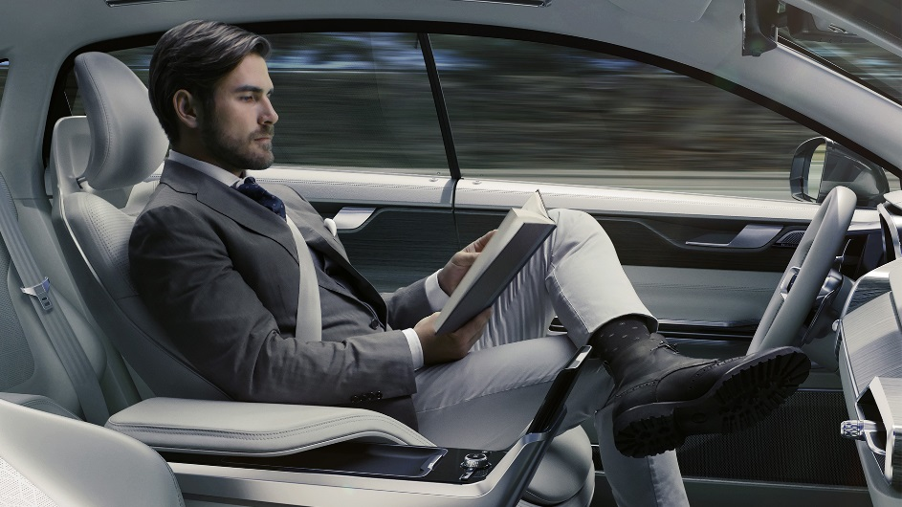
Automated Vehicles Will Save Lives, but …
How many?
When?
Knowing these things could …
Spur investment (private) – a bit of a chicken and egg
Inform policy and regulation (public) – more chicken and egg
Change safety “planning” and investment (public)
Engineering
Enforcement
Education
Emergency Response
How to know?

Slide 3
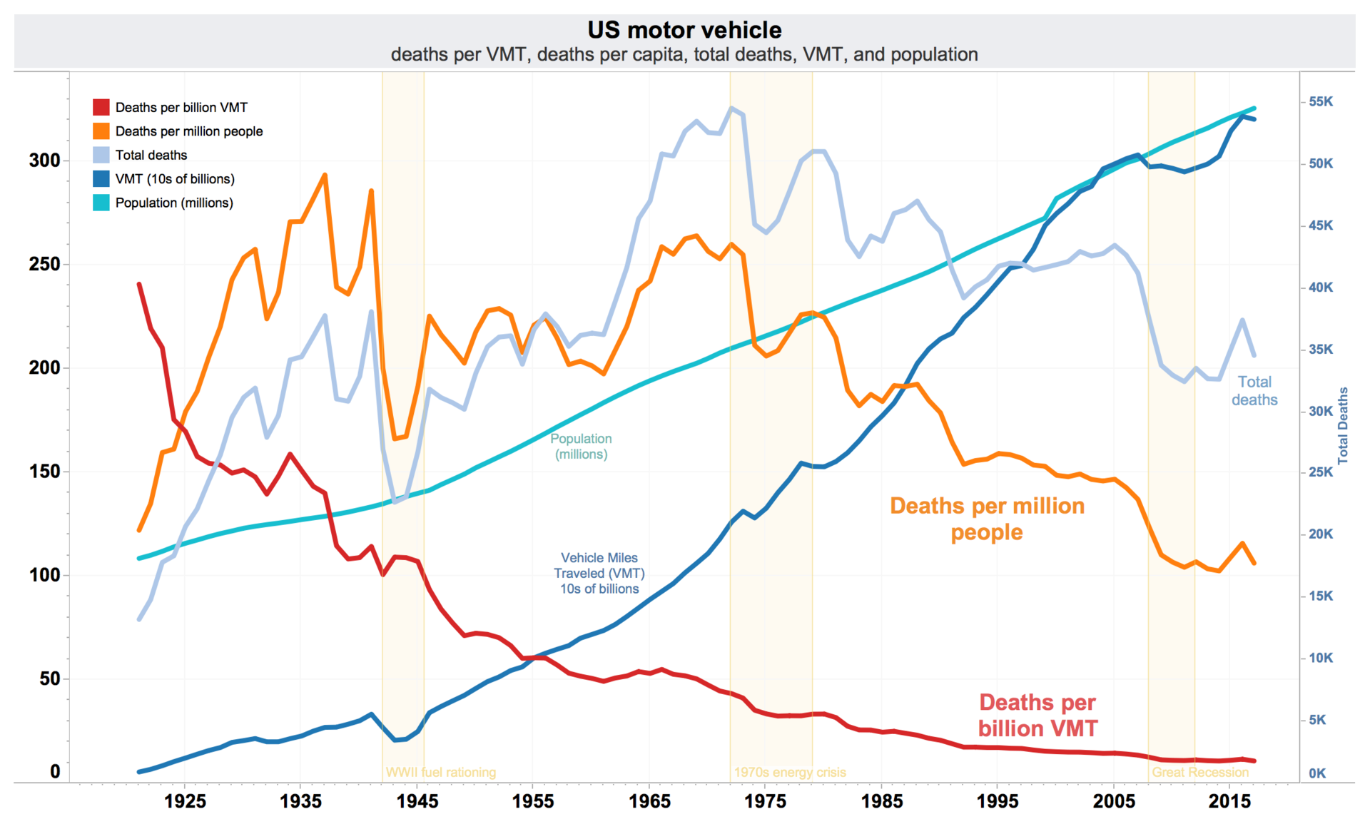
How many lives could be saved?
https://en.wikipedia.org/wiki/Motor_vehicle_fatality_rate_in_U.S._by_year#/media/File:US_traffic_deaths_per_VMT,_VMT,_per_capita,_and_total_annual_deaths.png

Slide 4
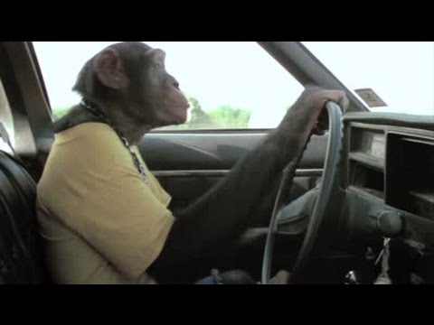
Safety the problem, CAVs the solution?
They say 94% of crashes are due to human error…
Can CAVs address all human factors?
In the long run even, some things might be “worse” …
“The human error components of walking, biking, motorcycle use will not be completely mitigated even with perfect automated vehicles. Also there is a residual category of tree falls on car, sinkhole, washed away in flood, suicide by auto, that won't be mitigated by smart cars” – S. Polzin, personal correspondence
Notes:
Money spent on AVs could be spent on less-expensive “safer” cars
Money spent on making the infrastructure work with AVs and CAV-tech enabled cars could be spent making roads safer for non-CAVs*
Interactions between AVs and non-CAVs may be more dangerous than a driver-operated system
Effectiveness requires proper use, can be a distraction, users compensate for risk
* some improvements may help both types of cars

Slide 5
But … Automated Vehicles Will Save Lives
How many?
When?
Knowing these things could …
Spur investment (private) – a bit of a chicken and egg
Inform policy and regulation (public) – more chicken and egg
Change safety “planning” and investment (public)
Engineering
Enforcement
Education
Emergency Response
How to know?

Slide 6
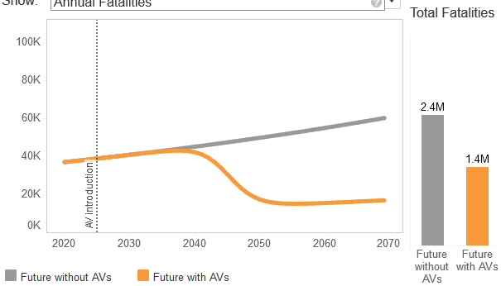
Really?*
Autonomous Vehicle Safety Scenario Explorer
link
https://www.rand.org/pubs/tools/TL279/tool.html
*even with no full AV, the safety curve would probably bend down (blind spot warnings, stability control, automatic braking, etc. )

Slide 7
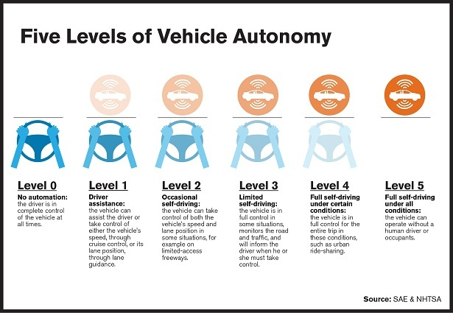
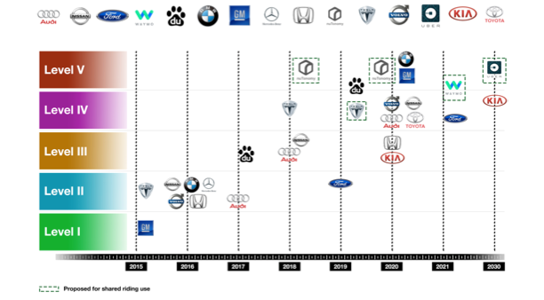
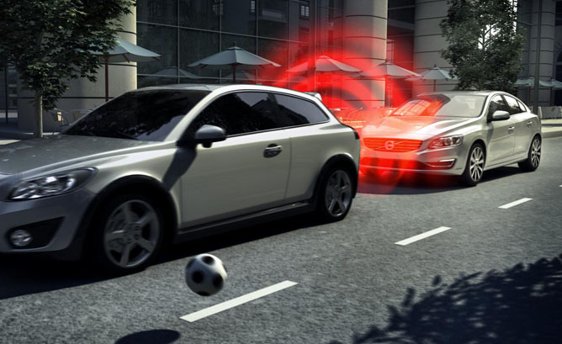
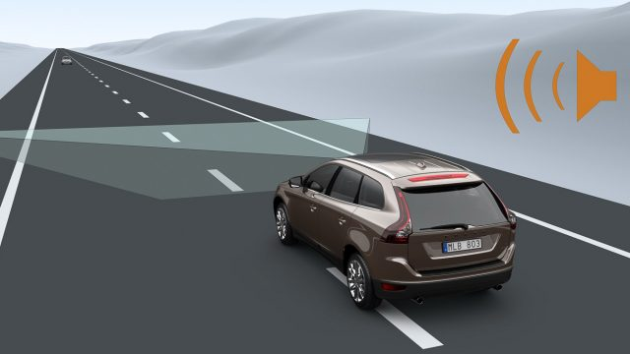
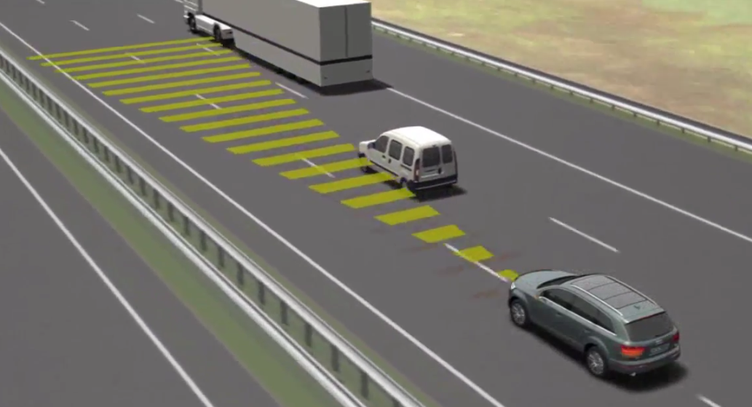
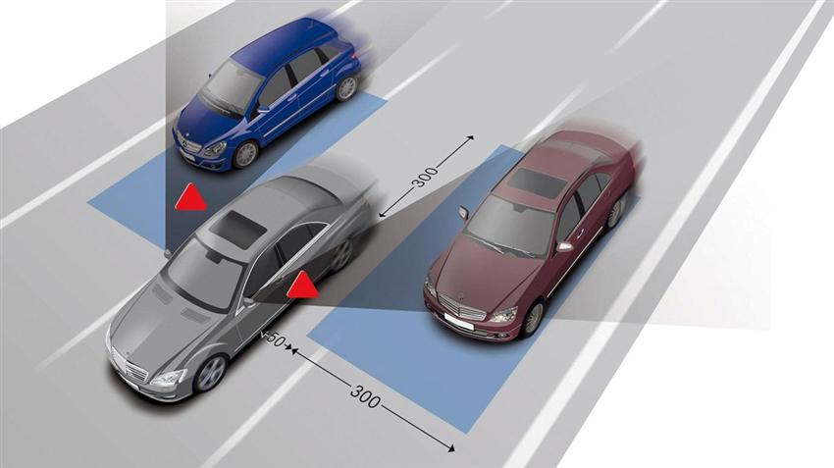
AV component technologies

Slide 8
How exactly do CAVs affect Safety?

Slide 9
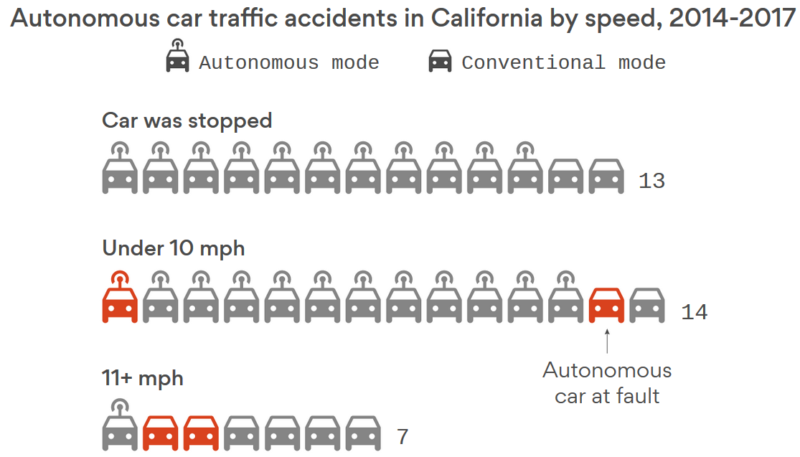
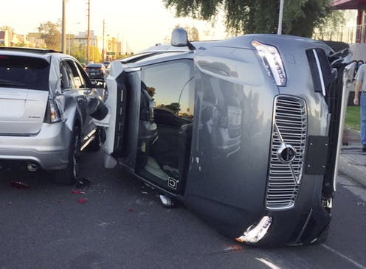
Time-Variant CAV Safety Performance
Interactions with non-CAVs
Initially, mixing in AVs may make things worse (for some crash types)
22 of 26 reported AV accidents, AV not at fault (CA crash study)
video

Slide 10
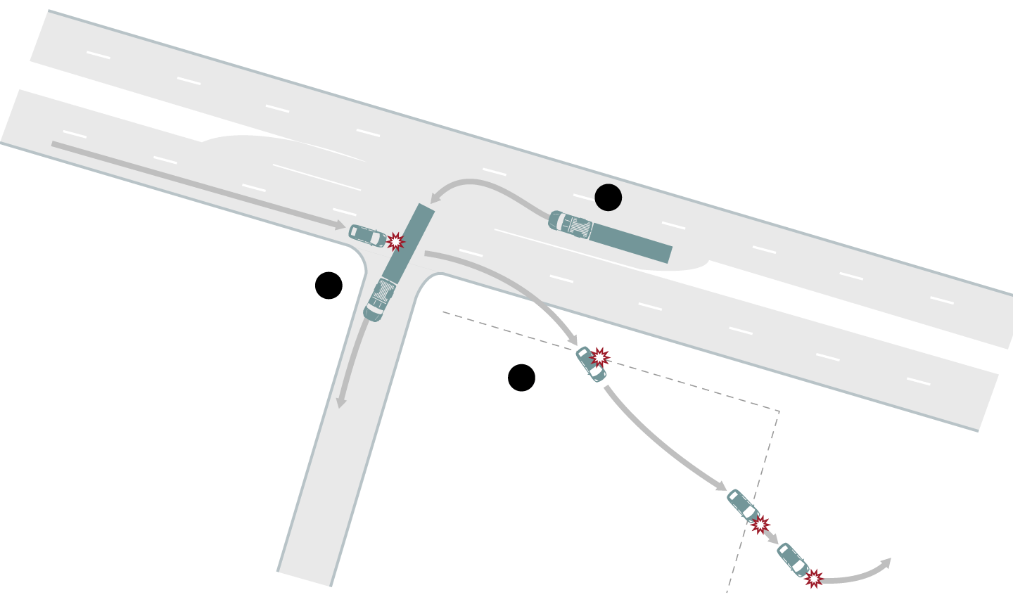
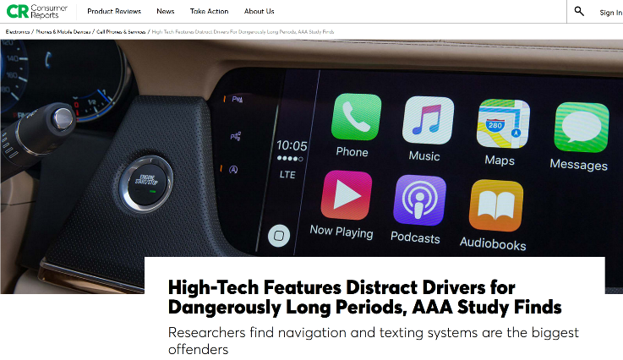
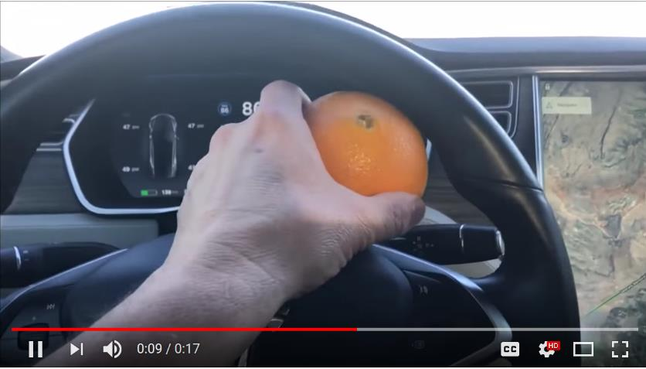
Distractions
Risk compensation
video
Proper
Utilization

Slide 11
Automated Vehicles Will Save Lives
How many?
When?
Knowing these things could …
Spur investment (private) – a bit of a chicken and egg
Inform policy and regulation (public) – more chicken and egg
Change safety “planning” and investment (public)
Engineering
Enforcement
Education
Emergency Response
How to know?

Slide 12
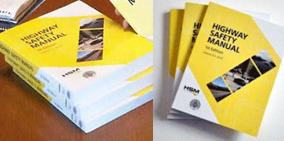
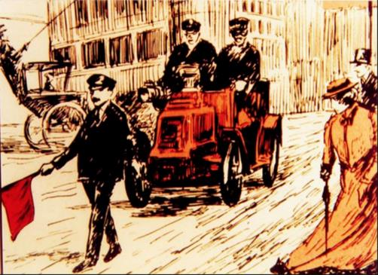
State of the Art Safety Data Analytics
Highway Safety Manual
Finally getting folks to accept Empirical Bayes (not everyone)
Some researchers pointing out limitations (exposure, temporal effects)
All assume static technology* – not even time series…
Sort of like estimating auto safety
using past performance of the horse!
* Also a problem for design standards, e.g., Green Book

Slide 13
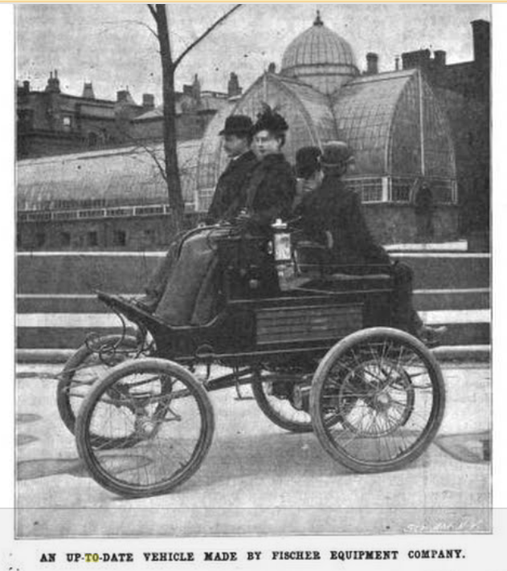
Let’s look back … Issues in 1900:
Notes:
Cars provided mobility, space and status
They were viewed as being safer than horses
Scientific American, 1900 “If there are faults with cars, only time is wanted to make them disappear … there is no mechanism more inoffensive, no means of transportation more sure and safe
Unlike horses, cars wouldn’t run away, bite or kick their owner, plus they were less costly to maintain
Less manure and airborne bacteria - By the1920’s, when cars had replaced horses, tuberculosis rates dropped
Horses stabled away from carriages, prediction of NYC 10’ deep in horse manure,
land for oats …

Slide 14
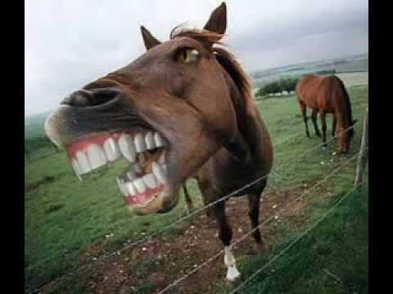
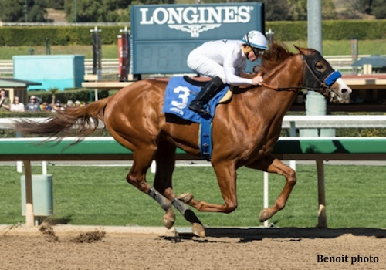
Horses were a real problem
I don’t think that was justified

Slide 15
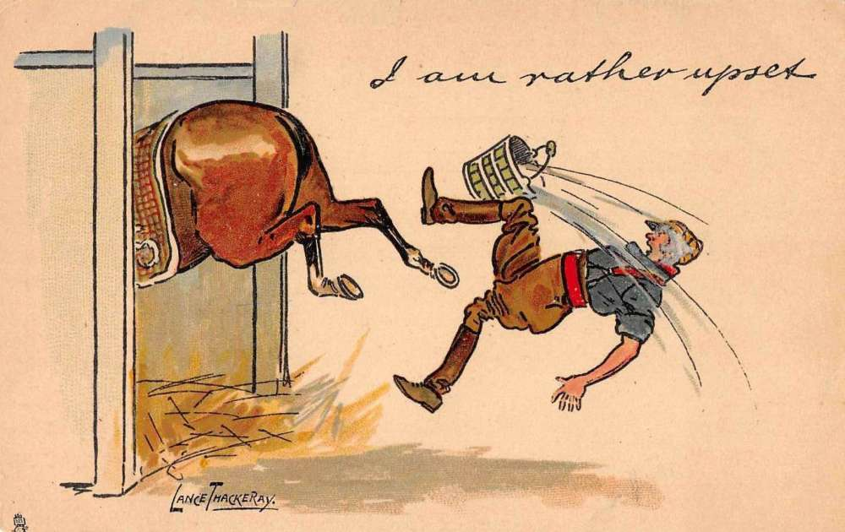
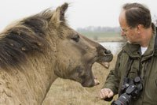
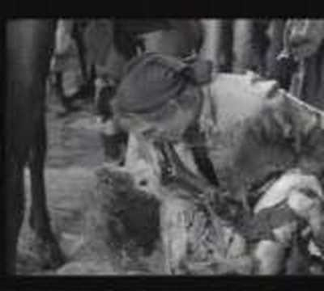
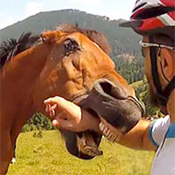
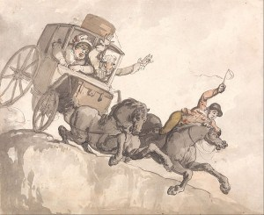
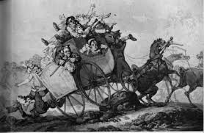
They bit, kicked and ran over people…
Notes:
Cars provided mobility, space and status
They were viewed as being safer than horses
Scientific American, 1900 “If there are faults with cars, only time is wanted to make them disappear … there is no mechanism more inoffensive, no means of transportation more sure and safe
Unlike horses, cars wouldn’t run away, bite or kick their owner, plus they were less costly to maintain
Less manure and airborne bacteria - By the1920’s, when cars had replaced horses, tuberculosis rates dropped
Horses stabled away from carriages, prediction of NYC 10’ deep in horse manure,
land for oats …

Slide 16
They transmitted tuberculosis…

Slide 17
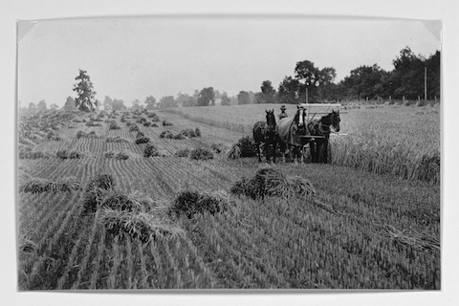
Human food cost increase due to competition from feed production

Slide 18
And, it’s real hard to think beyond something like this …
http://www.hhhistory.com/2017/08/the-great-manure-crisis-of-1894.html

Slide 19
The vision for cars …
“If there are faults with cars, only time is wanted to make them disappear … there is no mechanism more inoffensive, no means of transportation more sure and safe”
Notes:
Cars provided mobility, space and status
They were viewed as being safer than horses
Scientific American, 1900 “If there are faults with cars, only time is wanted to make them disappear … there is no mechanism more inoffensive, no means of transportation more sure and safe
Unlike horses, cars wouldn’t run away, bite or kick their owner, plus they were less costly to maintain
Less manure and airborne bacteria - By the1920’s, when cars had replaced horses, tuberculosis rates dropped
Horses stabled away from carriages, prediction of NYC 10’ deep in horse manure,
land for oats …

Slide 20
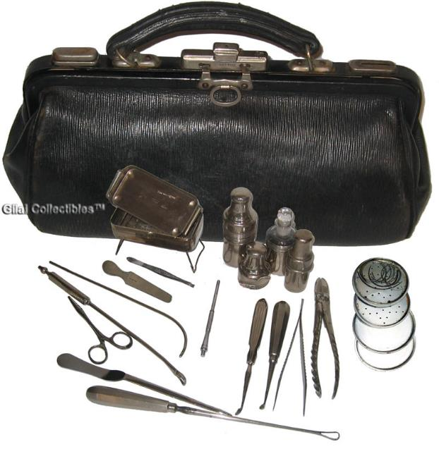
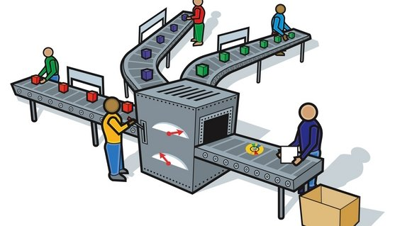
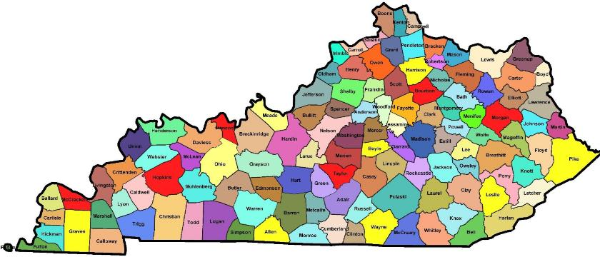
But, what really happened?

Slide 21
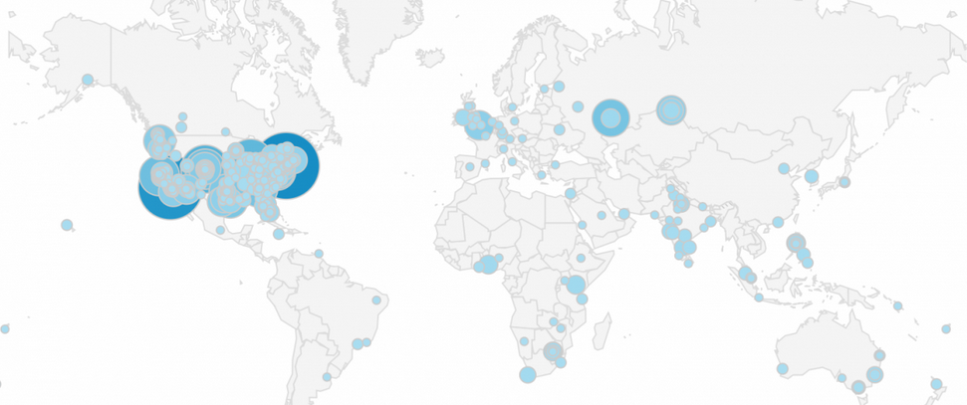

Slide 22
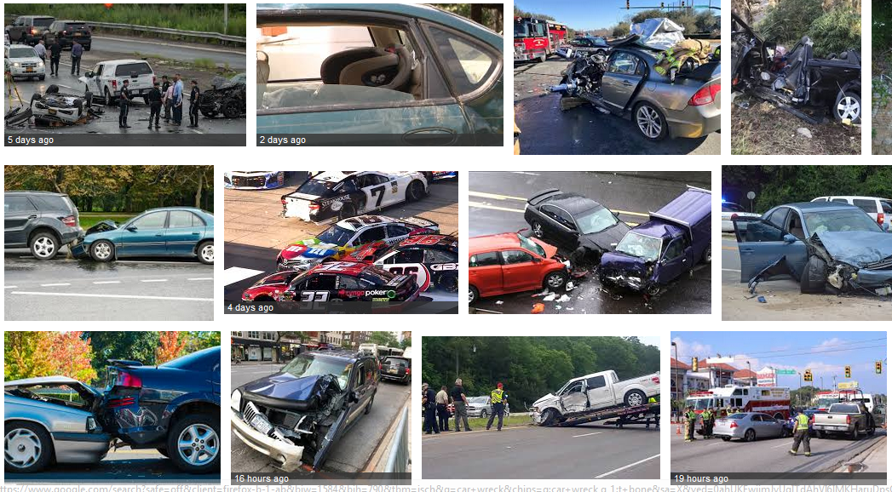

Slide 23
But … Automated Vehicles Will Save Lives
How many?
When?
Knowing these things could …
Spur investment (private) – a bit of a chicken and egg
Inform policy and regulation (public) – more chicken and egg
Change safety “planning” and investment (public)
Engineering
Enforcement
Education
Emergency Response
How to know?

Slide 24
Really?*
Autonomous Vehicle Safety Scenario Explorer
link
https://www.rand.org/pubs/tools/TL279/tool.html
*even with no full AV, the safety curve would probably bend down (blind spot warnings, stability control, automatic braking, etc. )

Slide 25
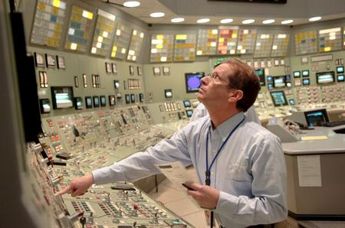
How ’bout some more dials?
Don’t we already have enough?

Slide 26
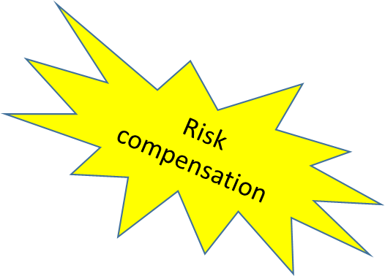
What will cause crash reduction/increase, how, when and how much?
Distractions
Interactions with non-CAVs
Proper
Utilization
Notes:
Update this slide

Slide 27
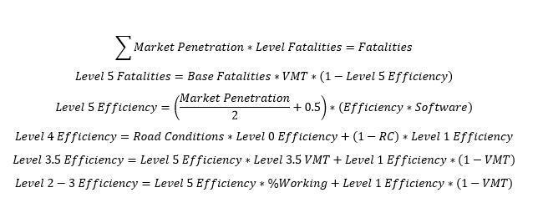
F=F₀ x G_{VMT} x (1-MP_{AV}) x (1-CRF_{AV}) x MP_{CAV tech} x (1-CRF_{CAV1}) x (1-CRF_{CAV2}) x …
SATURATION?
WHEN?
Logistic Function$Y\left(t\right)=A+\frac{K−A}{1+e^{−B(t−M)}}$
A is the lower limit, K is the upper limit
B is the growth rate
t represents the current year
M represents the year of 50% “penetration”
WHEN?
Reduction in Fatalities = f(market penetration, effectiveness)
Notes:
Gathering formulas now

Slide 28
Market Penetration = f (cost, regulation, acceptance…)
Effectiveness = f(technology, other factors)
Road system
Crash type
Crash conditions (e.g., environmental)
Causal factors
Proper Use = f(behavioral, quality, effectiveness, ease…)
Risk Compensation = f(behavioral, other)
Distraction = f(behavioral, familiarity, user interface quality/maturity, …)
Subject to … limits, interactions, etc.
Notes:
Gathering formulas now

Slide 29
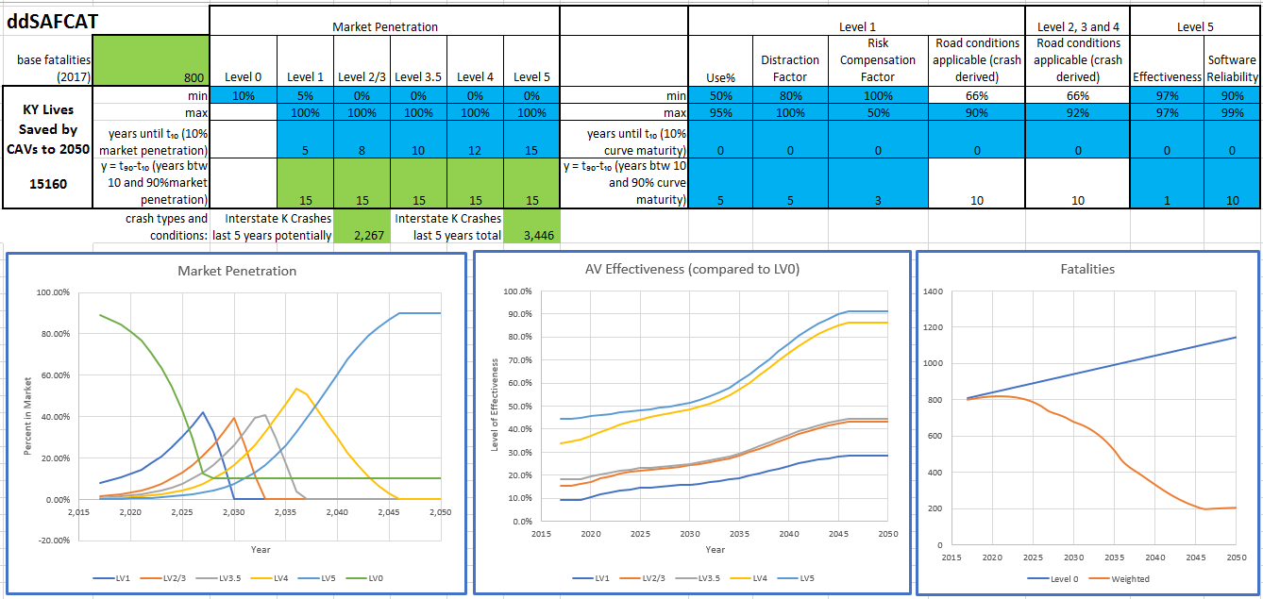
Notes:
update

Slide 30
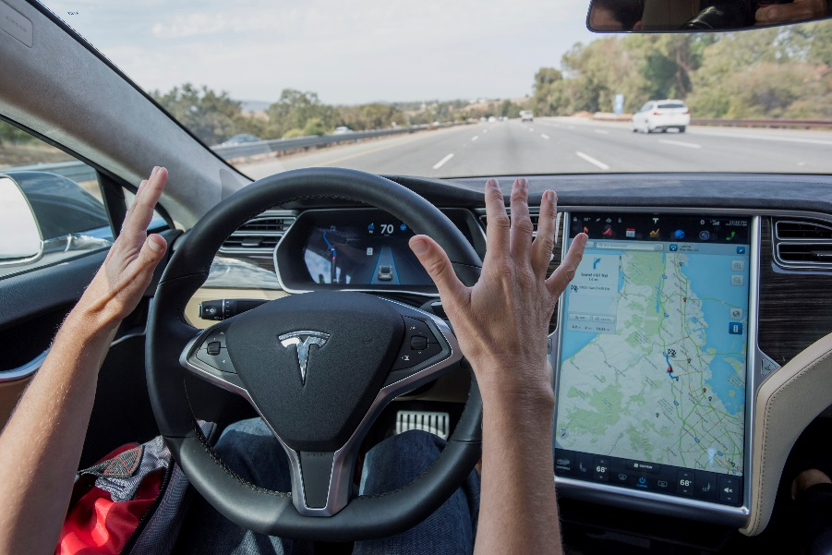
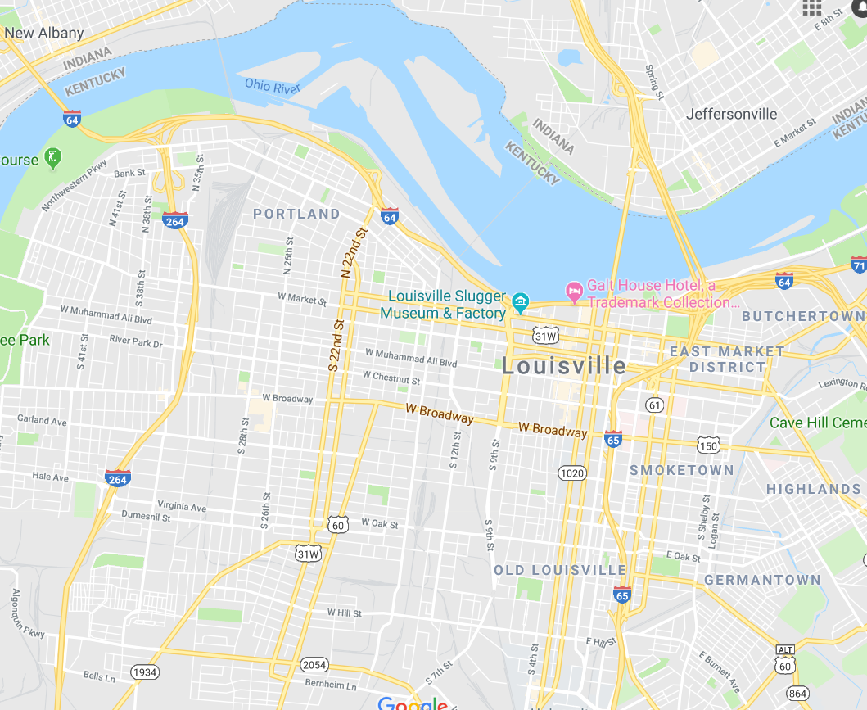
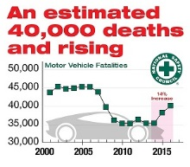
Assumes …
AVs all the same All roads the same All crashes the same
Notes:
Associate with %s of drowsy/distracted driving, rear ends, side swipes, and lane/road departure

Slide 31
Notes:
Associate with %s of drowsy/distracted driving, rear ends, side swipes, and lane/road departure

Slide 32
Inform with data!
Notes:
Associate with %s of drowsy/distracted driving, rear ends, side swipes, and lane/road departure

Slide 33
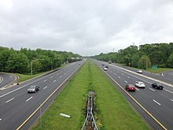
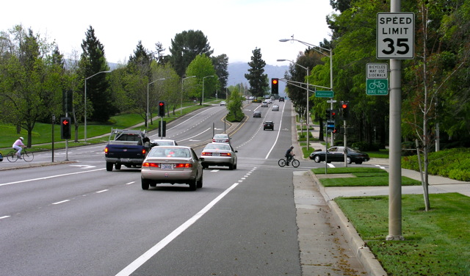
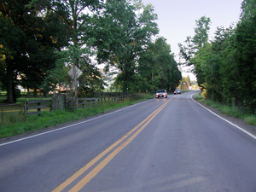
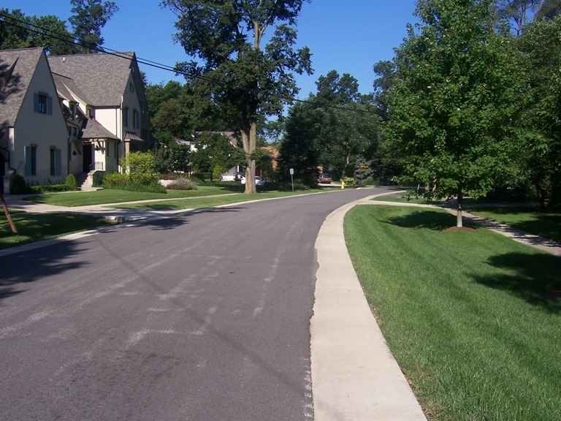
Inform with data!
Interstates
Arterials
Collectors
Local
Notes:
Associate with %s of drowsy/distracted driving, rear ends, side swipes, and lane/road departure

Slide 34
Inform with data!
Interstates
Arterials
Collectors
Local
Notes:
Associate with %s of drowsy/distracted driving, rear ends, side swipes, and lane/road departure

Slide 35
Automated Vehicles Will Save Lives
How many?
When?
Knowing these things could …
Spur investment (private) – a bit of a chicken and egg
Inform policy and regulation (public) – more chicken and egg
Change safety “planning” and investment (public)
Engineering
Enforcement
Education
Emergency Response
How to know?

Slide 36
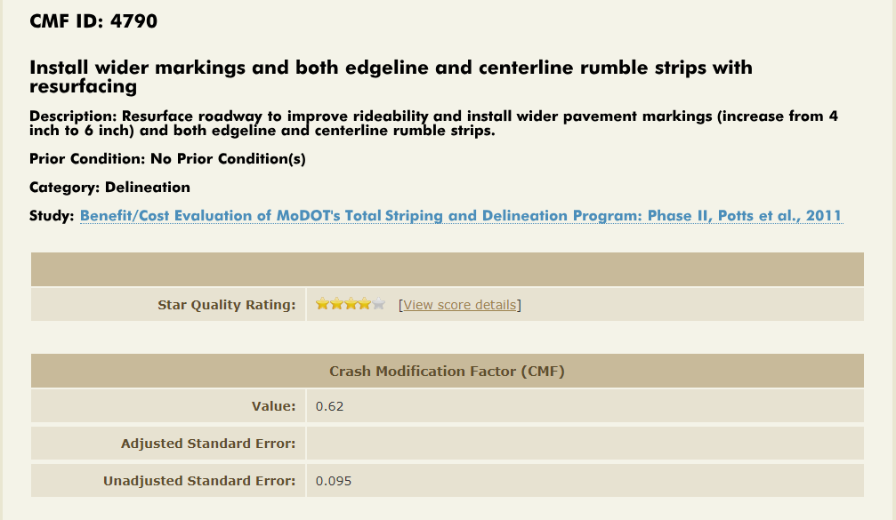
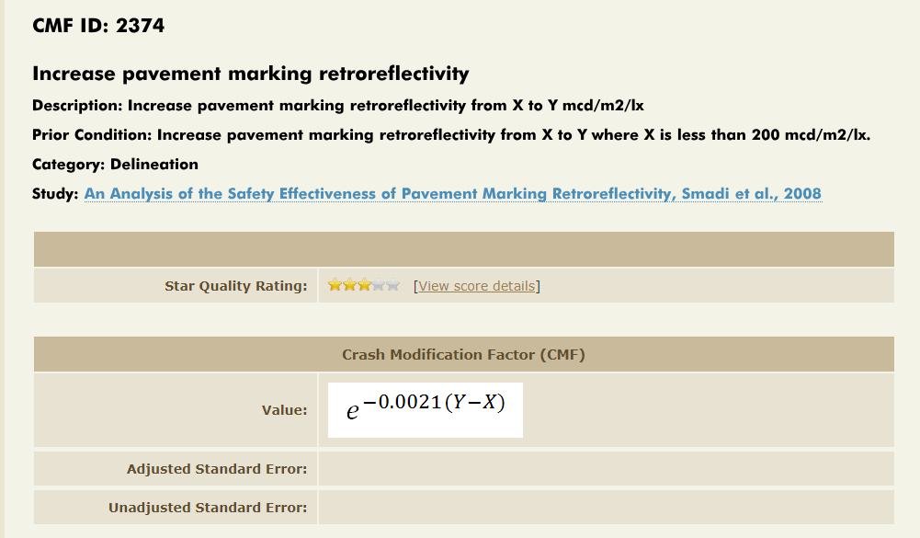
State of the Art Safety Data Analytics
Highway Safety Manual
CMFs
CMFs with CAV penetration > CMFs now (likely)
Some CMFs with CAV penetration < CMFs now (in a few cases)

Slide 37
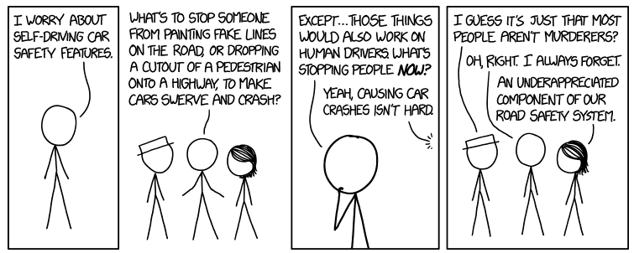
Questions/suggestions?
Thank you
Music city bowl pic
https://xkcd.com/1958/

